Slide 1
Restful Spring Based Web Service: Anova Calculation
Keith Rodgers

Slide 2
Background: ANOVA
ANOVA: an acronym for ‘Analysis of Variance’
A form of statistical hypothesis testing used in the analysis of experimental data.
Similar to t-test, but typically used when performing an experiment on 3 or more groups (t-test used for 2 groups)
Example: A company wants to measure the effect of certain weight loss methods on multiple groups of people. Each group uses the assigned methods and their weight is measured. An ANOVA analysis can help determine the best method based on the observed values (weight loss)

Slide 3
Background: Rest, Spring
REST
Resources expose easily understood directory structure URIs.
Representations transfer JSON or XML to represent data objects and attributes.
Messages use HTTP methods explicitly (for example, GET, POST, PUT, and DELETE).
Stateless interactions store no client context on the server between requests. State dependencies limit and restrict scalability. The client holds session state.
Spring
Framework for building web applications for the Java platform
Open Source

Slide 4
Problem
Design a RESTFUL Spring based web service which performs the ANOVA calculation given an input
Execute: Takes input data and returns the result when the computation is done
Submit: Returns an integer job id immediately without blocking the computation
Query: Takes input integer job id and returns the calculation or indicates the computation is not done

Slide 5
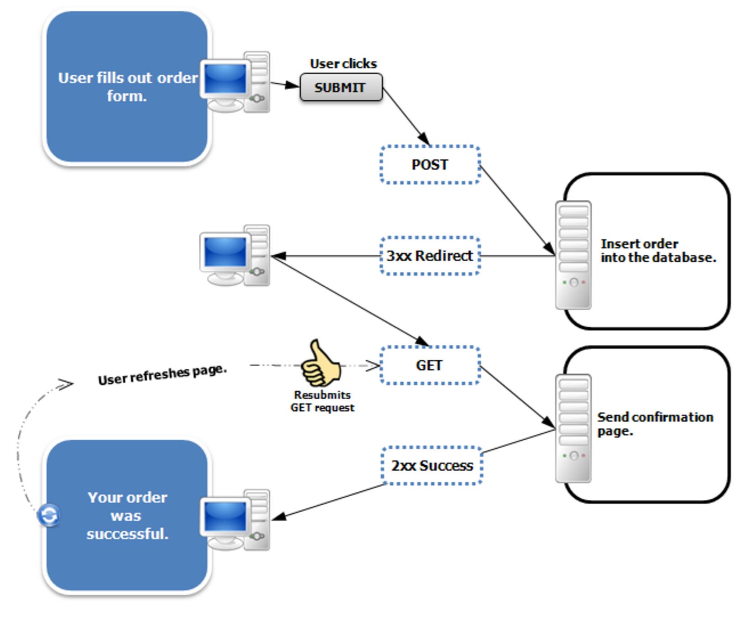
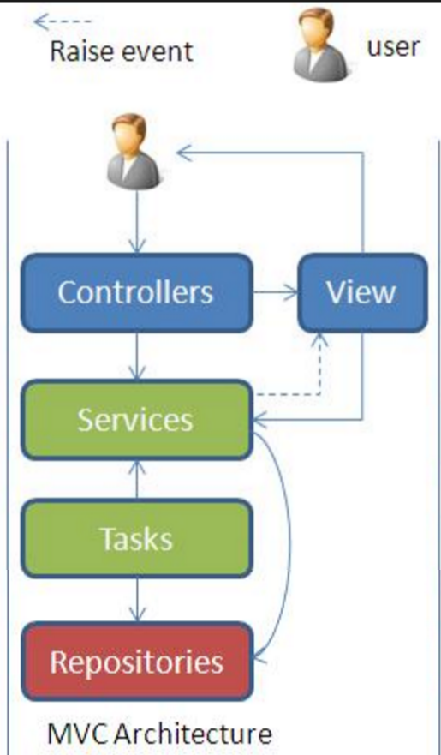
Methodology: Architecture

Slide 6
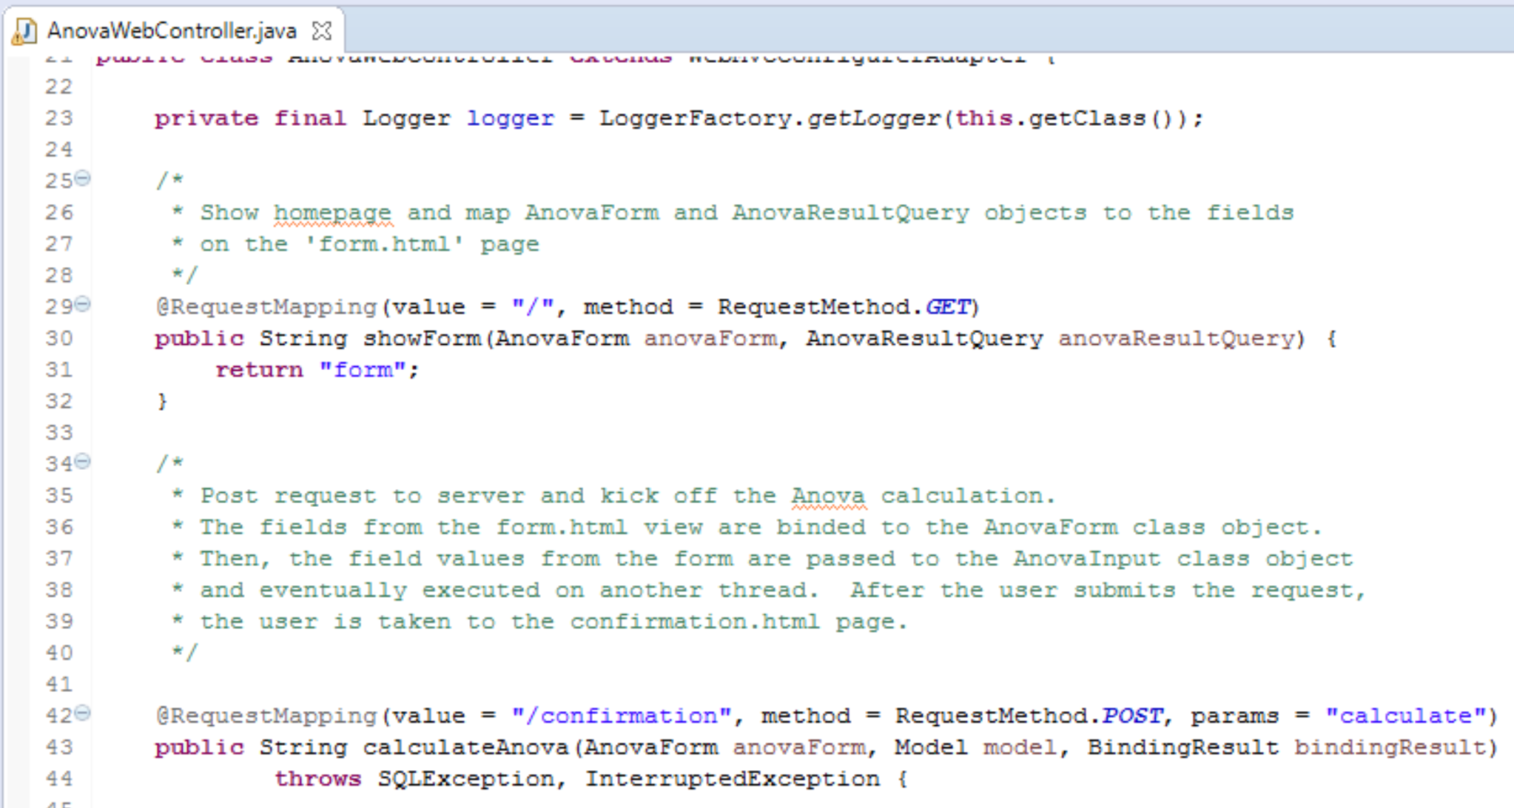
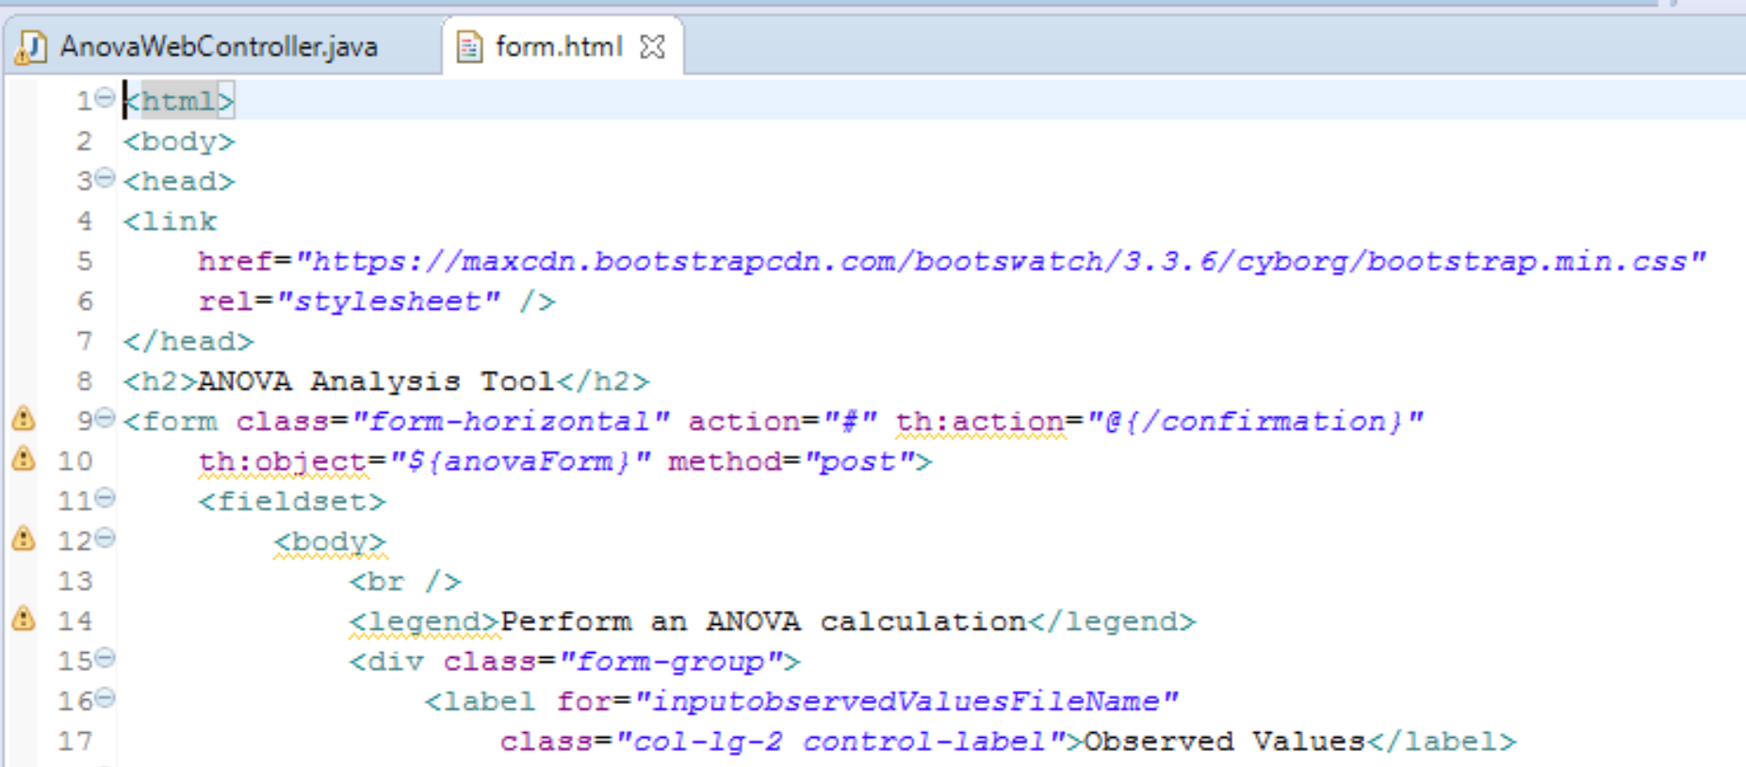
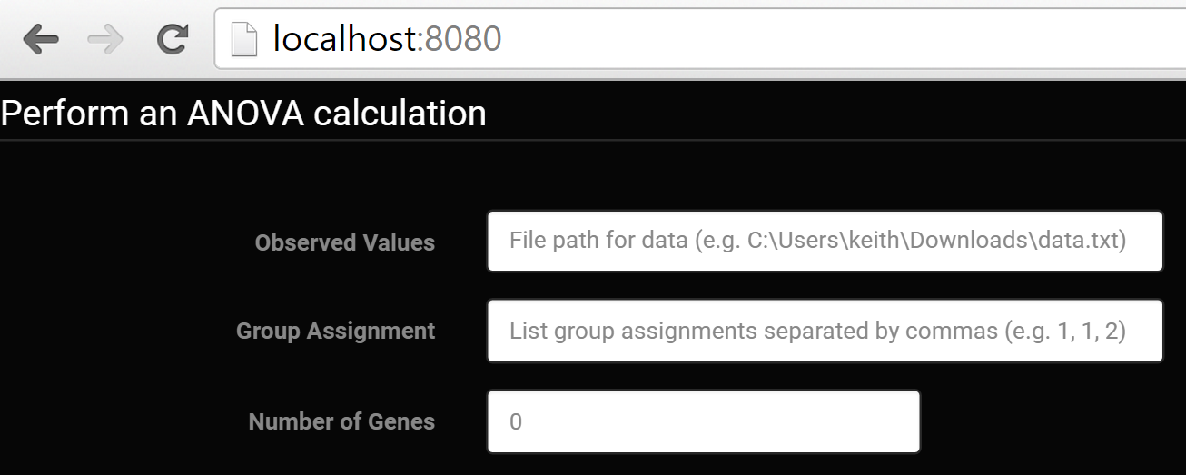
Methodology: Get Data

Slide 7
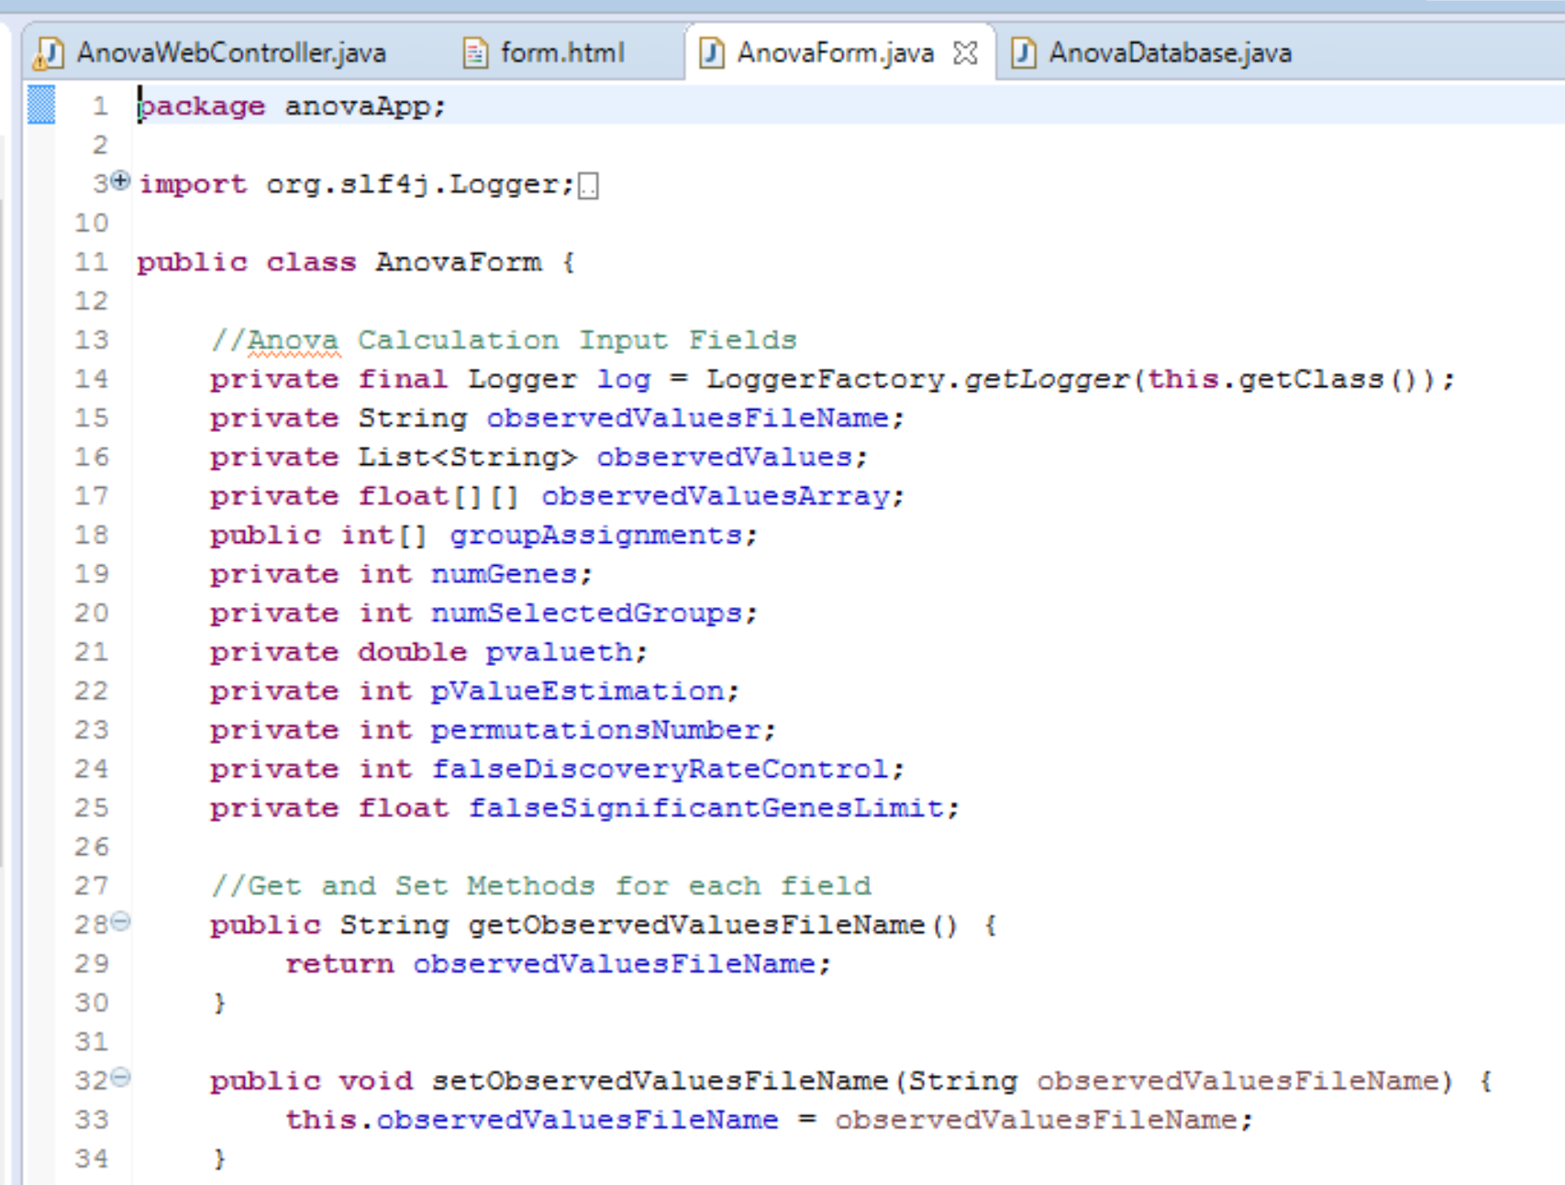
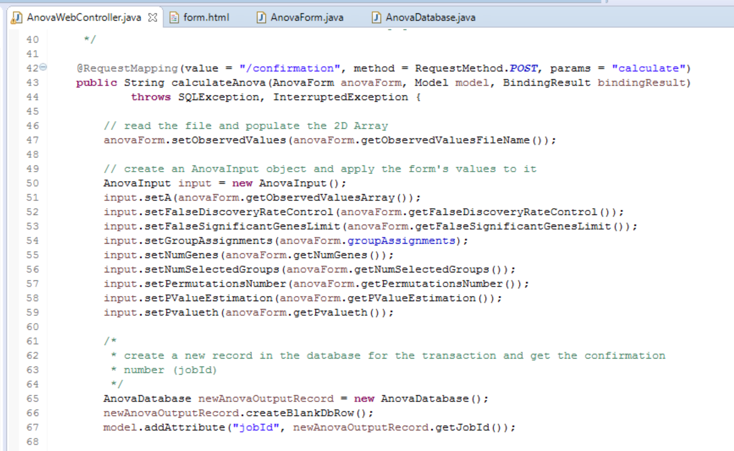
Methodology: Pass Data
Binding

Slide 8
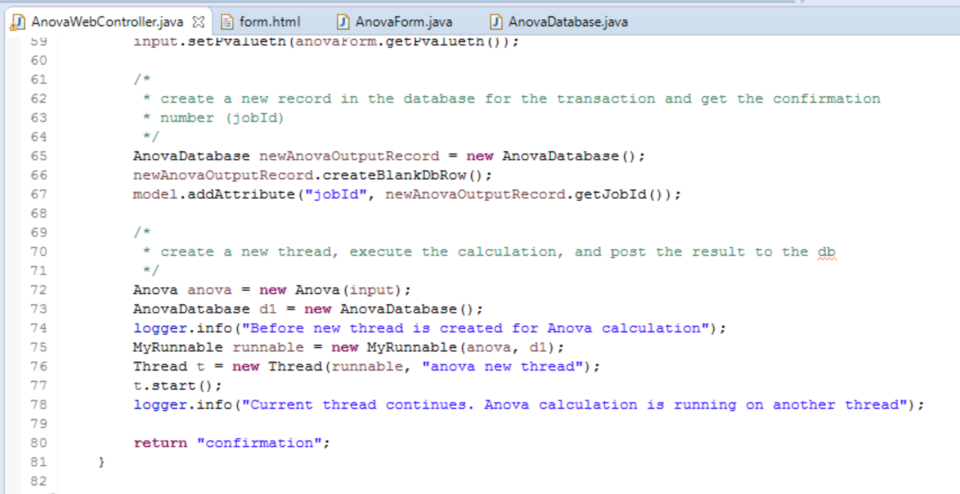
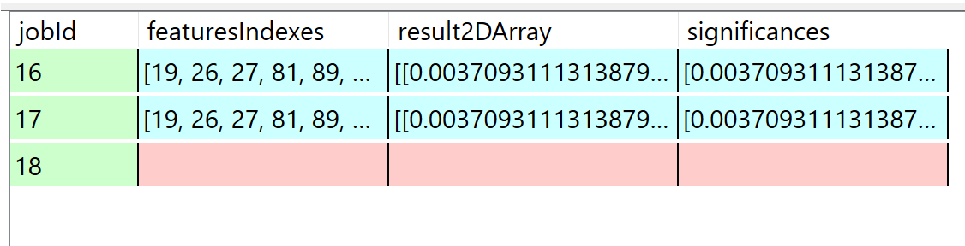
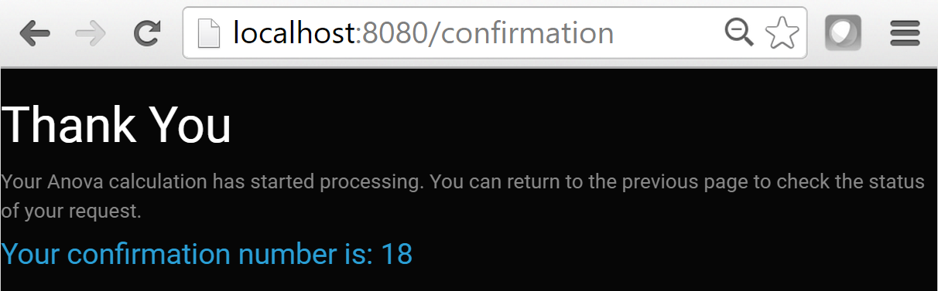
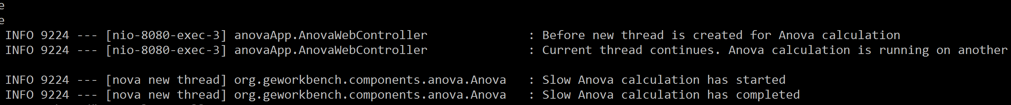
Methodology: Calculate Concurrently
1
2

Slide 9
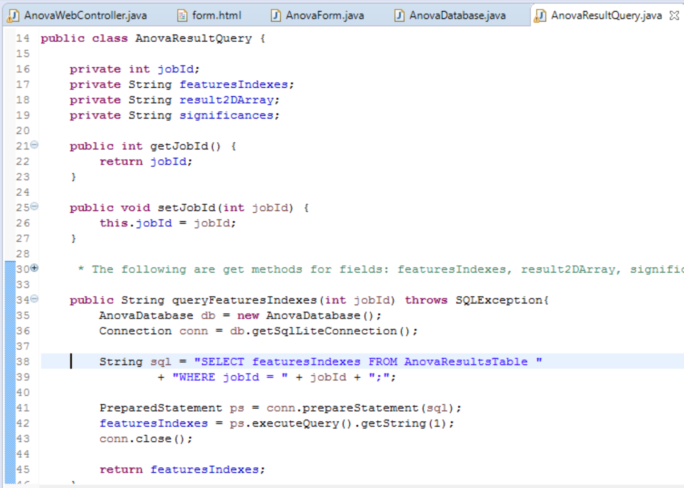
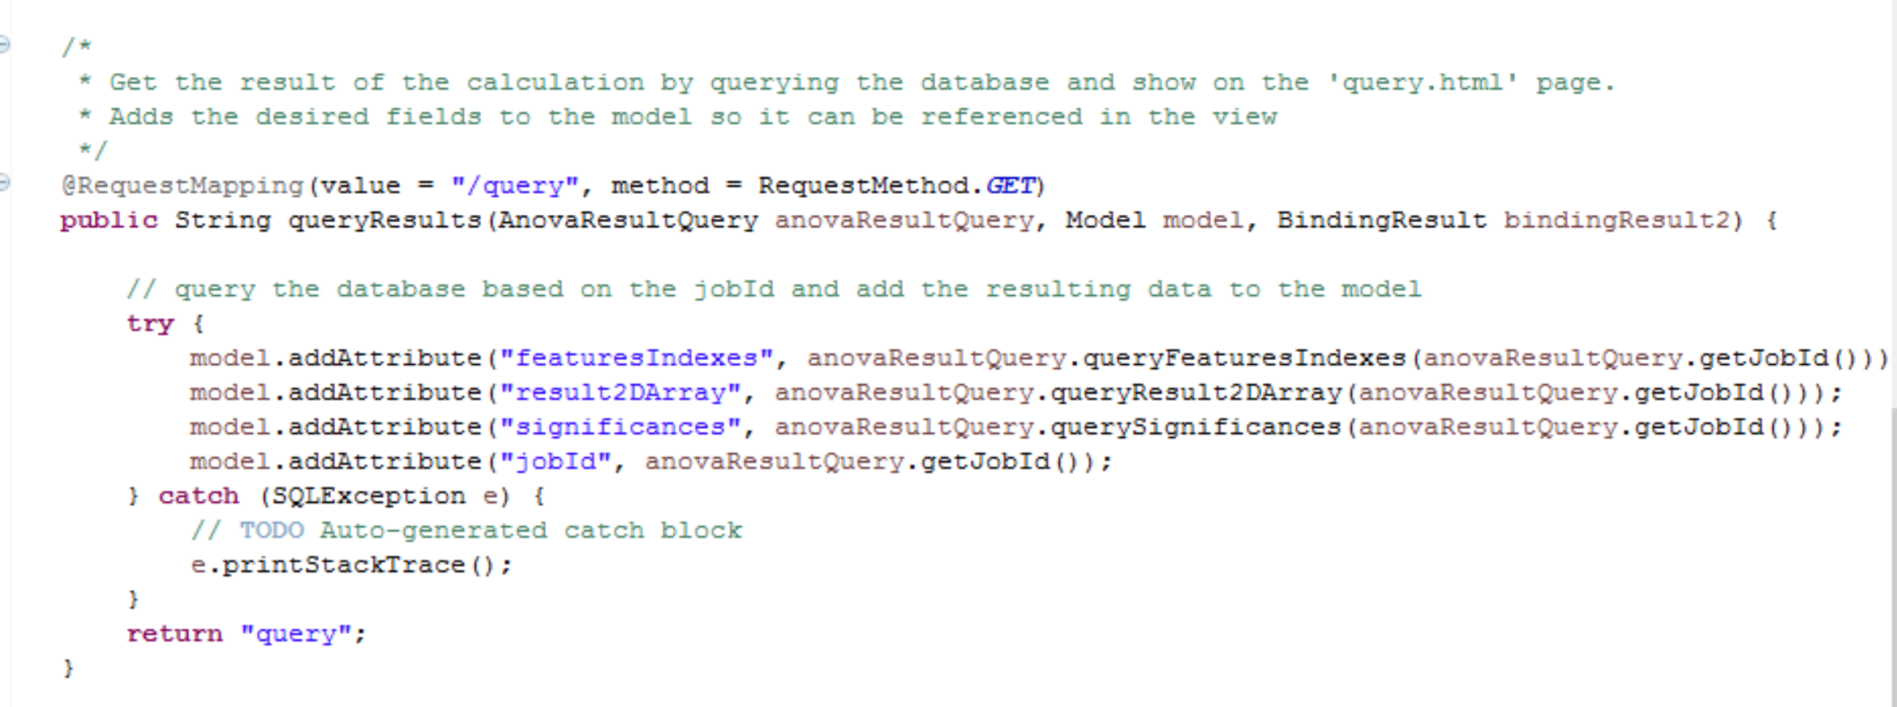
Methodology: Query Results

Slide 10
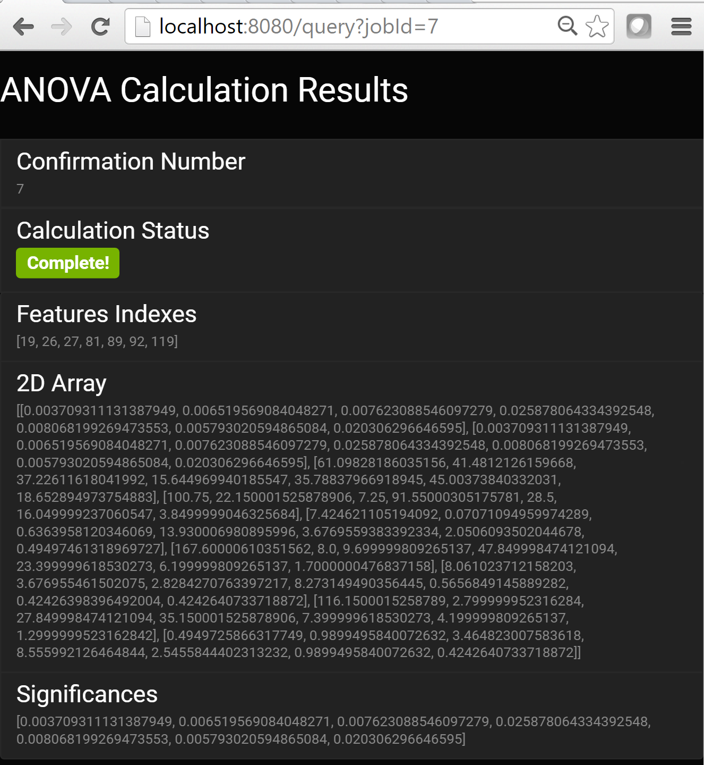
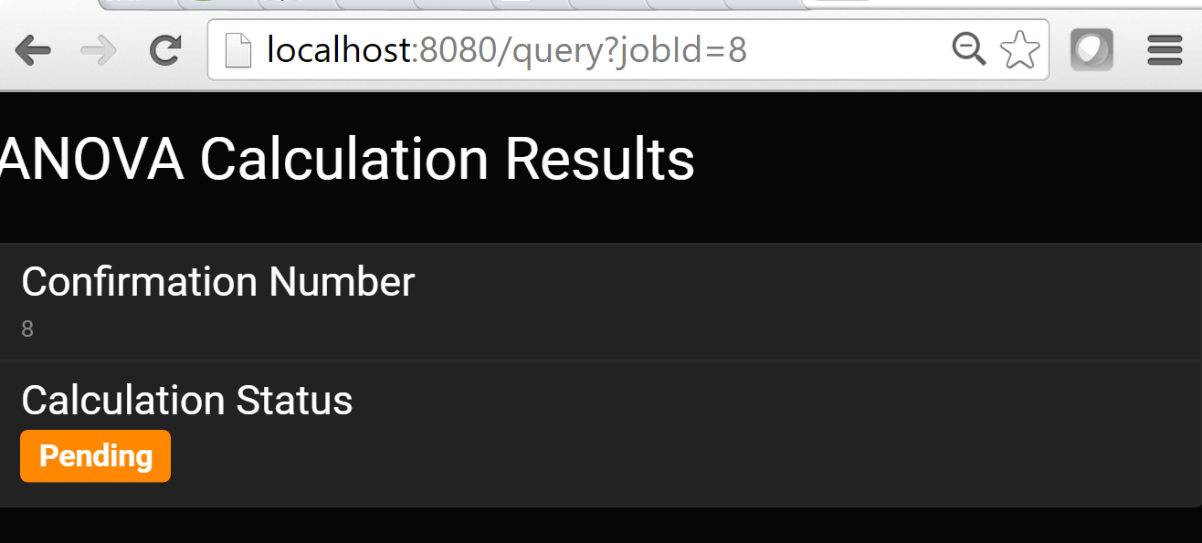
Results

Slide 11
Tools Used
Language: Java
Frameworks: Spring, Thymeleaf
IDE: Eclipse
Build: Maven
ANOVA Calculation
Used packages from geworkbench project which also referenced external libraries
Database: SQLite
Code Repository: Git
Version Control: GitHub app
Debugging
Logging: org.slf4j.Logger
Testing: J-Unit
CSS: Bootstrap (https://maxcdn.bootstrapcdn.com/bootswatch/3.3.6/cyborg/bootstrap.min.css)

Slide 12
Discussion
Next steps and learning lessons
Format the output nicely for the user
Better form input handling (e.g. 2D array) and form validation
Understanding of the business problem (for presentation)
Modeling before coding
Render JSON directly when representing the view (restful principle)
Most difficult part was integrating various frameworks and tools with Java (coding was easiest!)

